Slide 1
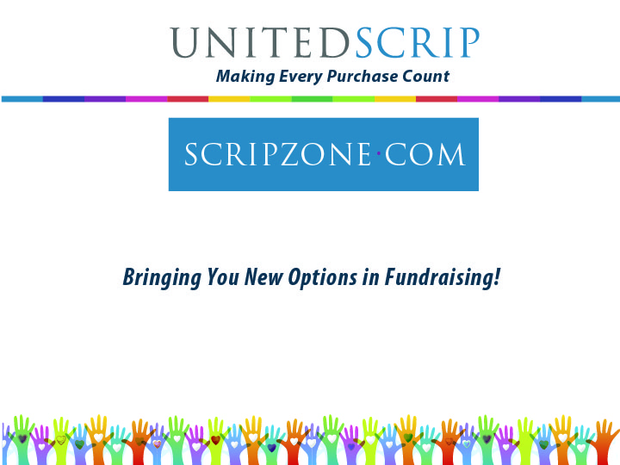
Notes:
Hello, My name is Carol Rampey, President of UnitedScrip.
The informal presentation is the first in a series of online presentations from our On-line Workshop Series and is intended as a general introduction to the Scrip Concepts for new groups and their board of directors, officers, coaches, teachers, or advisors.
This presentation is to introduce you to a program that provides a new solution in fundraising, one that perhaps can even change the focus of your fundraising activities. If you are searching for a means to raise funds for your organization, Scrip will come as a refreshing new concept. Scrip requires no door to door sales, and does not ask your members to sell goods or ask for pledges. Scrip is a program that actually aligns your members or families normal spending (or their normal budgeted spending) with the needs, goals and priorities of your organization.
Your first question then is probably… Tell me what ‘Scrip’ means?

Slide 2
Notes:
Scrip is a Latin Term that means anything used as cash…in our case, Gift cards and certificates, like ….
What you would purchase if you walked into any National Retailer and purchased a gift card as a gift for someone. Like

Slide 3
Notes:
These actual gift cards, identical to those sold in local grocery stores or department stores. Identical to what you would receive should you walk into any National Retailer and purchased a gift card as a gift for someone. Such as:
Best Buy, Circuit City,
⇒Macys, Lord and Taylor, Talbots, KOHL’S
⇒Toys-R-Us, The Children’s Place,
⇒Disney, that is good not only at entrance to parks but also for food, gifts, lodging inside the park, at stores in a mall near you or cruises. Carnival Cruise lines
⇒Barnes & Noble, Books a Million,
⇒BP Gas Cards, Exxon, Arco
Crate and Barrel, Bed Bath & Beyond
Restaurants like Golden Corral, Wendy’s, Red Lobster, Dunkin Donuts
Panera, Great harvest Bread Company, St. Louis Bread Company, Outback, Olive Garden,
⇒EBGames & GameStop, Sears, Office Supplies from Staples, Office Max or Office Depot.
Burger King, Cracker Barrel, Cheesecake Factory.
On line ordering from Amazon.com, iTunes,, L.L.Bean, Land’s End, Shutterfly.
Shell, Papa John’s, Pizza Hut, Red Robin
Speedway, Home Depot or Lowe’s. The list continues, but how will this form of Scrip help our organization?

Slide 4
Notes:
Let me explain how our program works for your organization. UnitedScrip purchases literally millions of Dollars in Gift Certificates and Gift Cards from National and Regional Retailers, meeting all minimum purchases to receive a volume corporate discount.

Slide 5
Notes:
UnitedScrip then retains on average .5% – 1.2% percent of the discount and passes the remaining discount, 1.5 % to 18% to the organization or non-profit group.

Slide 6
Notes:
YOUR ORGANIZATION will then offer these gift cards & certificates or SCRIP to the members of your organization at FACE VALUE, dollar to dollar.

Slide 7
Notes:
Your Profit is the difference between the cost paid by your group and the face value paid by your members. Let’s explore the concept further with examples of how it works and what your potential profit can be.

Slide 8
Notes:
Unlike traditional fundraising programs that require door to door selling of items by a sales force of children, Scrip asks one thing of our parents…time…time to think about what you will need to purchase over the next few weeks and decide to pre-purchase Scrip through your organization to pay for the items. Your profits will grow as your parents realize the potential that their everyday purchases can achieve for something they believe in and have committed to support.

Slide 9
Notes:
It’s a fact of life…we have to feed and clothe our families! We have to take them to school, ballgames and afterschool activities. We work to provide the means to do so. Normal weekly spending for groceries alone can exceed $100. What stock will generate a 5% return weekly on your $100, not money invested but Money that is spent to purchase your groceries, which your family consumes!
Let’s let at this concept closely by walking through the process….

Slide 13
Notes:
When you shop at the grocery store you gather items needed for the preparation of your meals, snacks and items for household maintenance. You have the option of paying for these items in one of 3 ways…check, cash or credit cards. All three purchase the $100 of needed items. Each payment method benefits the grocery store, bank or credit card company and everybody is happy, the Store is satisfied, their profit is secure because you have paid them, the community prospers and you have your groceries, life is good!. But those same purchases could have also benefitted your organization! HOW is simple…You receive an order form from your organization, you think about where you will be shopping this week. You order $100 dollars in gift cards from your organization for items you need for next week, groceries, clothes, soap, gas, light bulbs, choosing participating retailer,. You write a check to the organization for $100 (or your normal budgeted amount spent weekly). Because you chose to order gift cards from a participating Retailer, your organization retains a profit of 3% - 5% of your normal purchases, generating $3 -$5 in profit for items you purchase weekly!

Slide 18
Notes:
Let’s begin with just one family. I have purposely been conservative with these figures, and you can use the calculator provide in the support materials to quickly gather that information, but using these figures, $200 gas, $400 in Groceries, just $150 in Restaurants, Clothing $100, even though that is maybe 2 pairs of shoes, and $75 for household items that you might purchase from Lowes, Kmart or Home Depot. Together these items total $925. Let’s look at these figures and use 25 members making purchases.
In 10 months your members will spend in the community,
$231,250.00
And it is a tremendous boost to the economy for your area, however that could generate a Potential Profit in 10/month of ⇒$11,062.50

Slide 19
Notes:
eGifts extend your profit generating potential in several ways
1 – for those members who want to order but don’t want to wait to receive a card
2- great way to send a gift
3 – supporters from around the country can order and pay for eGifts and no one has to worry about how they are going to get the cards to the individual placing the order.

Slide 23
Notes:
UnitedScrip offers your members two options for online payment: Credit cards or setting up withdrawals from their personal bank account. The options that you allow will be shown to the members when they are choosing the details for their order in the beginning of the process.
Please Note: When opting to use a credit card for payment, the discount listed reflects a drop in percentage from the discounts listed for payment directly to the organization. This is necessary because UnitedScrip passes the entire discount through to the groups or nonprofits except 1%, which will not cover the cost of processing the credit card or paying the fees they charge retailers to allow payment with a card. In other words there are no fees to your organization, but the profit is less per item ordered, and cards are not available if their original discount is less than 3%.

Slide 24
Notes:
UnitedScrip works with Payment Gateway, a National Provider of secure, online payment systems, The Federal Reserve and your banking institution to provide this service. Your Group must have established the availability of this payment option.
UnitedScrip’s easy and convenient option for your families to pay your organization online for their Scrip orders, anytime night or day from the convenience of home. UnitedScrip will electronically accept payment on behalf of your non-profit organization.

Slide 25
Notes:
The ScripPayment Gateway does require a short setup process. Your families will have to register at ScripZone.com and join your organization before they can begin the process.`
ScripPayment Gateway will take your members through the process in a step-by-step format. UnitedScrip also has a flyer with detailed instructions and pictures that you can send to your members or link on your website.

Slide 30
Notes:
Once again we want to Thank you for the opportunity to present this Introduction to Scrip Presentation to your organization. We hope that it has given you the information needed to make a decision concerning the possibility of utilizing Scrip to impact your organization. It is our goal to perhaps play a small part in helping your organization to reach it’s goals and to realize it’s vision for tomorrow! With a program that simply makes every purchase profitable for your group. If you have additional question we can be reached by calling UnitedScrip, Inc. at: 1.864.886.9701 or email us at info@unitedscrip.com

